Slide 1
NBA Return on Investment Project
Chinedu Okeke, Alex Grimm, Jordan Kakuyo

Slide 2
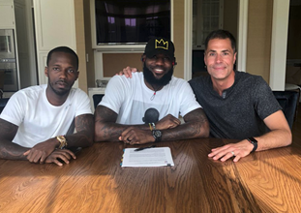
What We Do?
Every year NBA teams make signings and trades to add players and picks to their rosters for improvement
All of these acquisitions require giving out a contract, giving up draft capital, or both
We want to make sure that teams are using their limited resources wisely, and not overpaying/overvaluing any potential players they add to their team.

Slide 3
Key Stakeholders
Internal Users:
Our Company:
employees need access to the system in order to update data, resolve issues, and make changes
External Users:
NBA Organizations:
team executives can utilize this tool in order to assess player worth
Agents & Players:
ensuring that client value is being met within contract negotiations

Slide 4
Database Composition
Includes 11 tables
Teams
Colors
Team_colors is an association table between teams and colors
Drafts
Team_drafts is an association table between teams and drafts
Players
Salaries
Positions
Player_positions is an association table between players and positions
Player_statistics
team_statistics

Slide 5
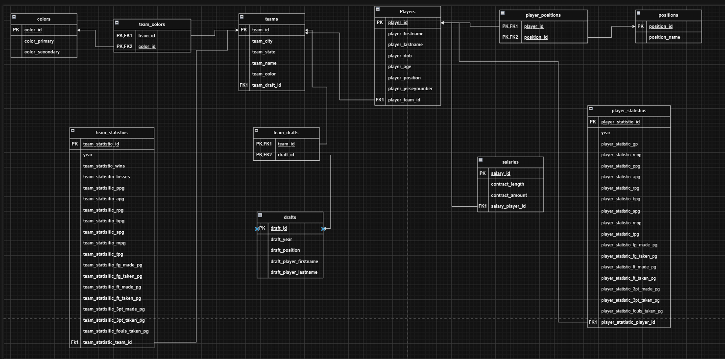
Logical Data Model

Slide 6
Project Composition
7 Code files that are necessary to run
2 Triggers
Limit space on active team roster to 15
Limit the amount of money a team can spend on players during a season
7 Functions
Used to gather player and team information, as well as to search for players with certain point, rebound, and assist values
8 Views
Show different projections of player and team data throughout the database
6 Stored Procedures
Used to streamline data insertion in the database

Slide 7
Demo
We will explore a player John Smith
This player averages:
17 points per game
5 assists per game
5 rebounds per game
Our Demo will explore how this player compares to other players across the league

Slide 8
Summary
Many NBA teams don’t utilize cap space to their full advantage
Our database allows front offices to explore potential trades and how it will affect their teams
Players can also utilize this resource to compare their stats and contracts to players with similar characteristics to ensure that they are earning what they deserve
There are methods in place to ensure that teams do not violate league policy

Slide 9
Thank You

Slide 10
References
Data for our project was sourced from BasketballReference.com

